Slide 1
Bank Loan Case Study
By A . Ayyappa

Slide 2
Project Description
In this project, we aim to analyze a loan dataset at a finance company that specializes in lending various types of loans to urban customers. Company facing a challenge like some customers who don't have a sufficient credit history take advantage of this and default on their loans. We are going to use Exploratory Data Analysis (EDA) to analyze patterns in the data and ensure that capable applicants are not rejected.

Slide 3
Tech-Stack Used
I used Microsoft excel to read and convert the data frame according to our needs.
I used Microsoft PowerPoint to make the report and graphs to represent the project report clearly.

Slide 4
Approach
Data Collection: analysis can help identify patterns or relationships that may not be apparent in the overall dataset.
Bivariate Analysis: We have box plotted some variables like total income, credits based on educational qualification and family status. Which will help in describing how the loan approval rate varies by loan amount, credit score, or other demographic factors.
Data Visualization: We have created charts and graphs to visualise data. We also used box plots and whiskers to visualise IQR and outliers.
Bivariate Analysis: We have box plotted some variables like total income, credits based on educational qualification and family status. Which will help in describing how the loan approval rate varies by loan amount, credit score, or other demographic factors.
Data Visualization: We have created charts and graphs to visualise data. We also used box plots and whiskers to visualise IQR and outliers.
Query Merging: We have performed inner merging of two tables on Excel.

Slide 5
Data cleaning
Here I used counta function to count total columns/variables . Then found the percentage of the null values in the each columns using the formula –(total rows count of each column /total rows count) *100
After that we can remove the columns which having > 30% of null values. And columns having less than 20 % perform distribution statistics for finding missing values by mean ,median, mode etc.
Here I change some columns which are having negative date values which I converted them in to days in years dividing by 365 days.
51 columns having null values percentage more than 30 % are removed.
I also found the outliers with the help of interquartile range method considering relevant variables.

Slide 6
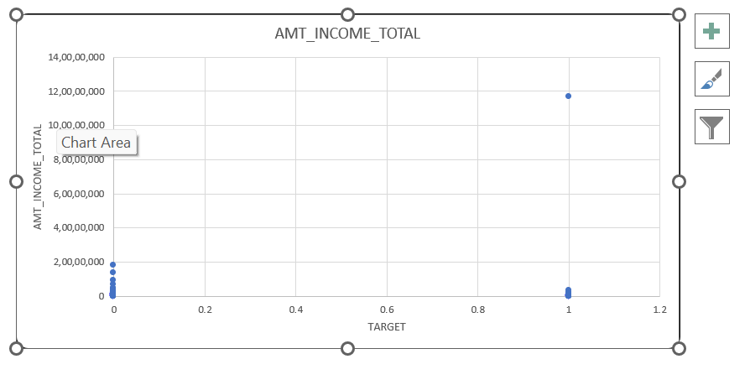
oultliers
In this plot we see that the target variable 1 there are few applicants who draw an income of 11 cores where as majority of the applicants drawing an income in lacs only.

Slide 7
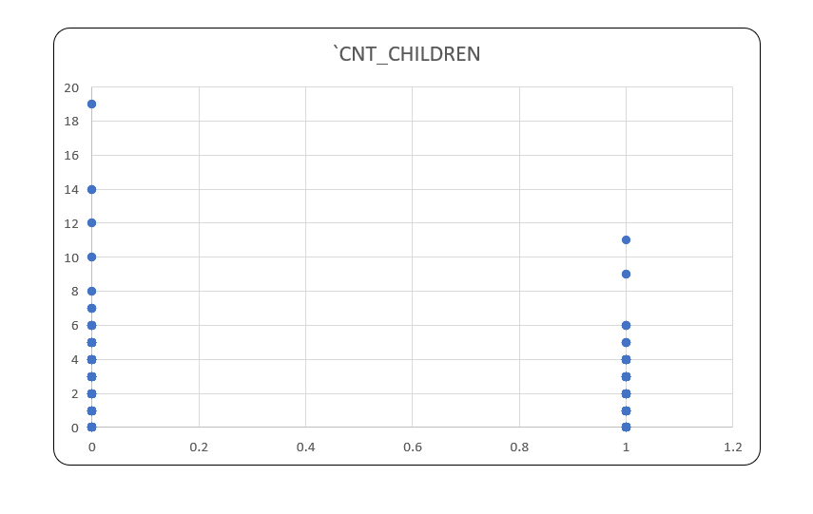
Outliers
In this plot we can see that for the target variable 0 applicants having max 19 children which is highly unusual in these days where as target 1 applicants having max 11 children only.

Slide 8
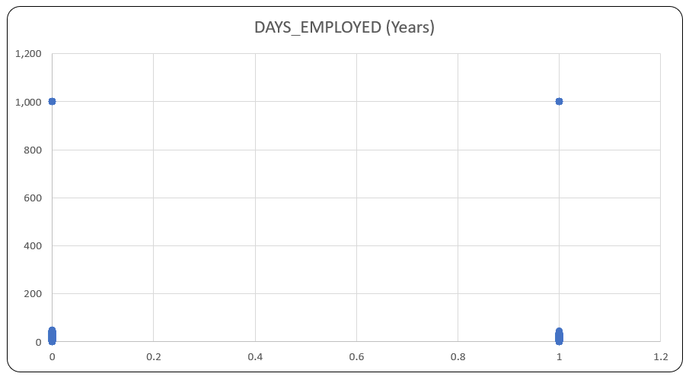
Outliers
In this plot we can see that there are few applicants in target 0 &1 were employed for 1000 years which is impossible where as majority of the applicants are employed for around 80 -90 years .

Slide 9
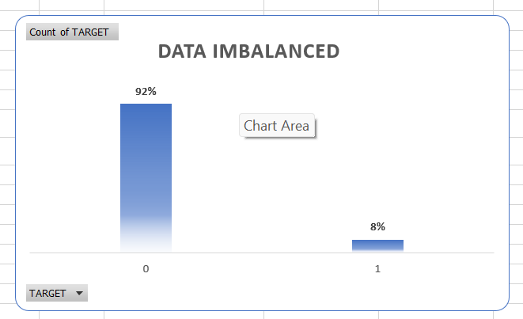
Data imbalance
The data imbalanced sheet show the ratio of total applicants with payment difficulties i.e target 1 to the total applicants with the payment mode on time.
Out of total applicants 307511 the percentage of applicants which makes payments on time is 92 % thus makes a majority class where as the percentage of the applicants in payment difficulties is 8 % thus makes a majority class.

Slide 10
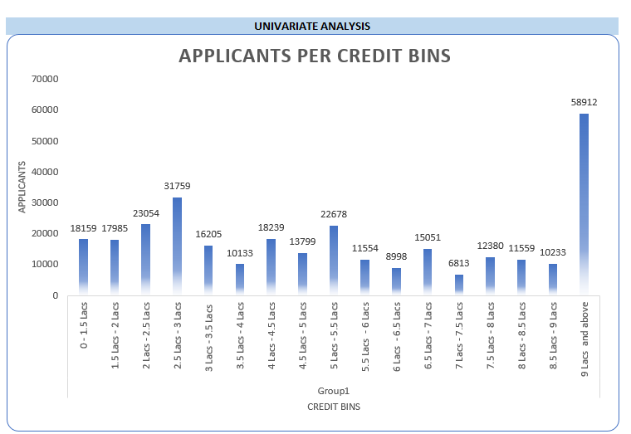
Univariate analysis
Univariate analysis refers to the analysis of data contains only one variable. It does not deal with causes or relationship and the main purpose of the analysis is to describe the data and find patterns which exists in it.
This graph is an example of univariate analysis which shows the count of every applicants (0&1) of columns AMT_Credit grouped in to different income bins .majority of the applicants have got the loan approval of credit range 9 lacs and above.

Slide 11
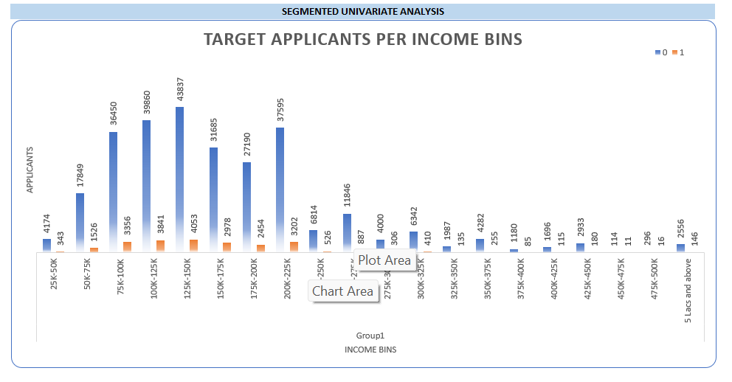
Segmented univariant analysis
Segmented univariant analysis is refers to the data contains only one variable . Here segmented analysis refers to the analysis in subset of variable.
This graph is an example of segmented univariant analysis that shows most of the applicants(0&1) drawing an income between 1lacs - 2.25 lacs.
Very few target 1 applicants are drawing an income 5lacs and above. Thus which can be reason of difficulty in payment.

Slide 12
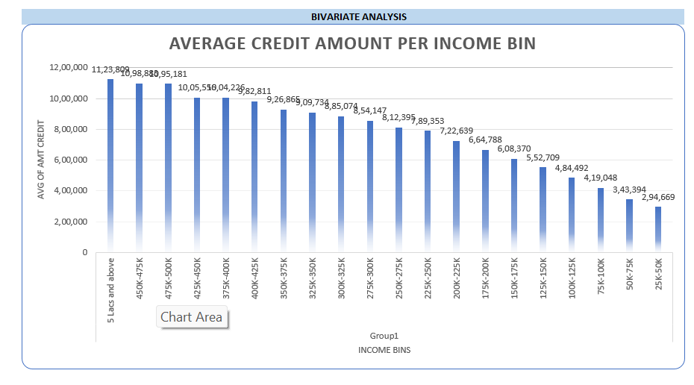
Bivariant analysis
Bivariant analysis refers to the data contains two different variables. It deals with the causes and relationship and the main purpose of analysis is to find that relationship among two variables.
The graph shows the relationship among applicants and different income bins which are directly proportional to each other.
Thus the income increases the amount credit will also increase .

Slide 13
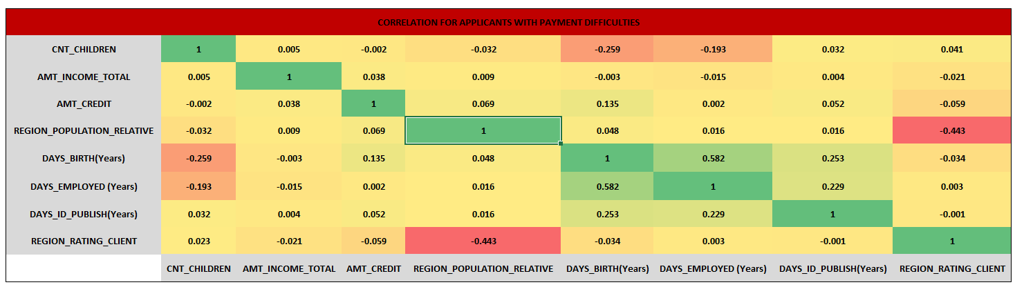
Correlation
The heat map shows the correlation between the different variables for target 0 i.e applicants with payment made in time .
Thus most relevant correlation among –
amt_total_income to amt_credit
days_birth to days_employed
days_employed to days_id_publish.

Slide 14
Result
This project helps in understand why data cleaning is most important step in analysis a particular dataset.
Gained deeper knowledge on how we can identify outliers in the dataset and how important they are to identify
Data imbalance in the dataset help in understand the inaccuracy of our analysis
How to draw chart based on different scenarios and pivot tables
Finding the correlation between different variables.

